Slide 1


Slide 2

Objectives
- explain concept of ‘ effective demand’
- identify the nature of demand curve
- identify factors influencing demand
- explain movement along the demand curve

Slide 3

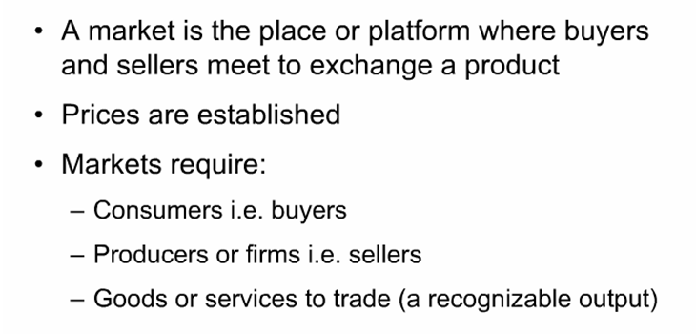
Market:

Slide 4

In the market buyers demand G &S
Demand :
The quantities of a good that consumers are willing and able to buy at different prices in a specified period, ceteris paribus

Slide 5
Effective Demand:
When consumers’ desire to buy a good is backed up by an ability to pay for it.
They must have sufficient purchasing power

Slide 6


Slide 7
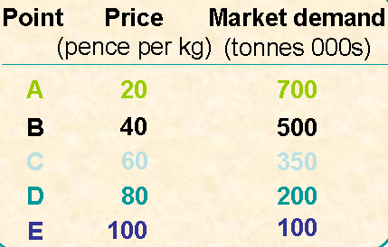
Demand schedule

Slide 8
Demand schedule
A table showing the different quantities of a good that a consumer is willing and able to buy at various prices over a given period of time – individual demand schedule
A table showing the different total quantities of a good that consumers are willing and able to buy at various prices over a given period of time – market demand schedule

Slide 9
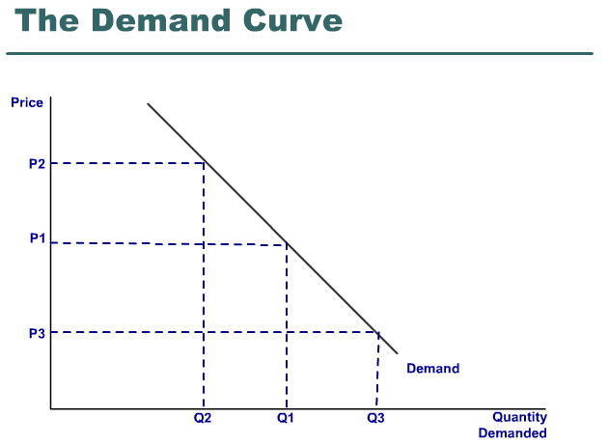

Slide 10
Demand curve
A graph showing the relationship between the price of a good and the quantity of the good demanded over a given period of time
A demand curve can be for an individual consumer or group of consumers or more usually for the whole market

Slide 11
Demand curve
Slopes downwards/negative slope due to the law of demand
Law of demand
  When price of a good rises, the quantity demanded will fall, other things being equal or vice versa
  Price and quantity demanded are inversely related

Slide 12
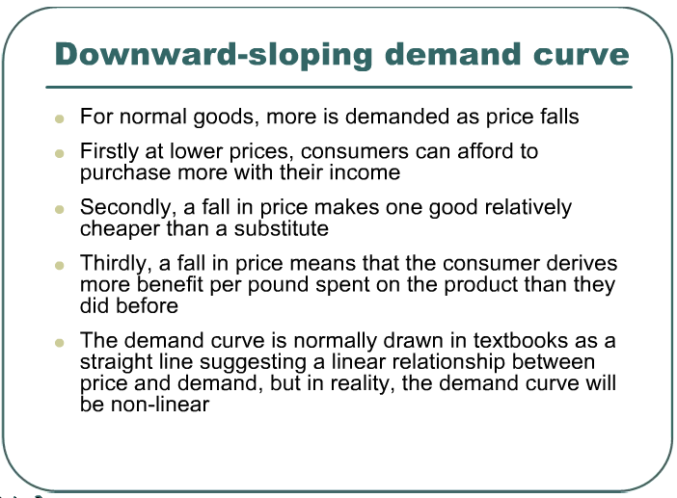

Slide 13
Price :
A change in price involves a movement along the demand curve

Slide 14
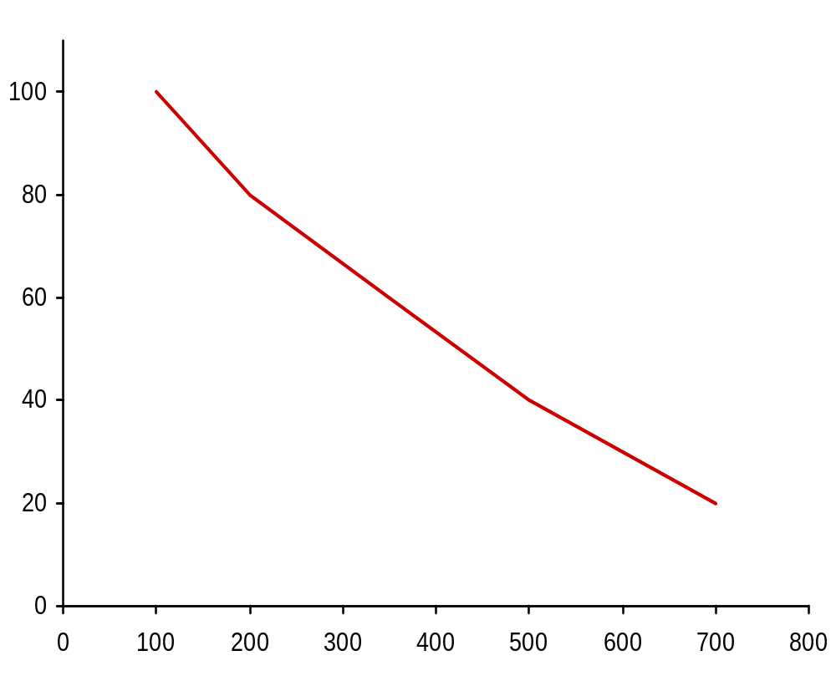

Market demand for potatoes (monthly)
E
Point
Price
(pence per kg)
20
40
60
80
100
Market demand
(tonnes 000s)
700
500
350
200
100
A
B
C
D
E
D
C
Price (pence per kg)
B
A
Demand
fig
Quantity (tonnes: 000s)

Slide 15
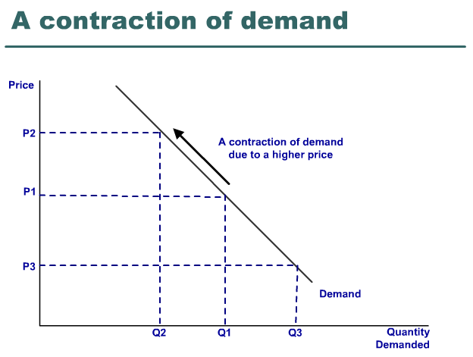

Slide 16
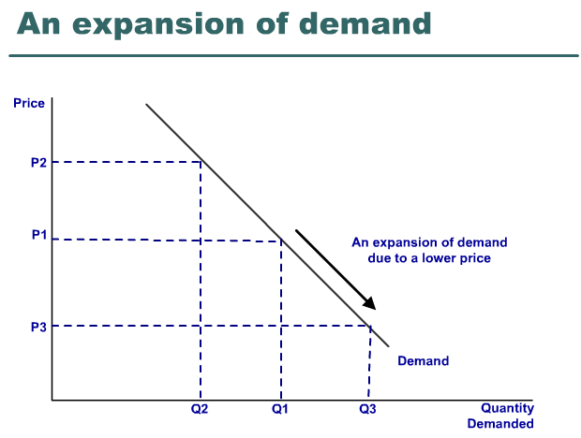

Slide 17
Movement along the demand curve
When price rises, quantity demanded falls.
  Causes an upwards movement along the demand curve
  Known as a contraction of demand
When price falls, quantity demanded rises
  Causes a downwards movement along the demand curve
  Known as an extension or expansion of demand
THESE CHANGES ARE KNOWN AS A CHANGE IN QUANTITY DEMANDED – CAUSED BY CHANGES IN THE PRICE OF THE PRODUCT ITSELF, CETERIS PARIBUS

Slide 18
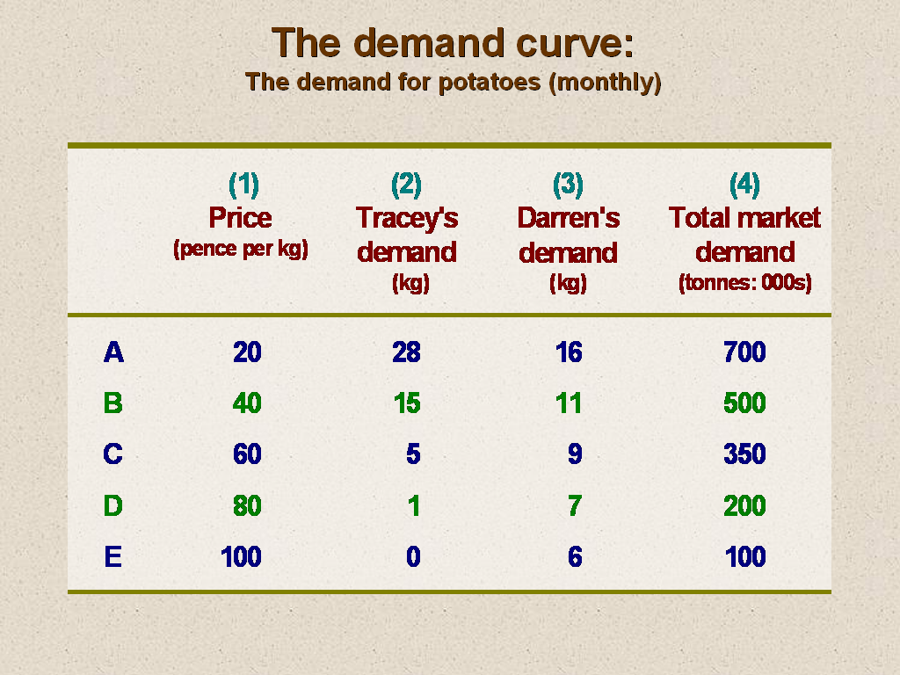
DEMAND
Movements along and shifts in the demand curve
  change in price
    ⇒ movement along D curve
  change in any other determinant of demand
    ⇒ shift in D curve
      increase in demand ⇒ rightward shift
      decrease in demand ⇒ leftward shift
Notes:
3

Slide 19

Individual & Market DD
Market demand curve is obtained by horizontal summing of Individual demand curves

